Slide 1
Hardware Workshop #2
Geoff Spielman - 2017

Slide 2
Outline
Button Debouncing
Example
PWM for LED Brightness
Example

Slide 3
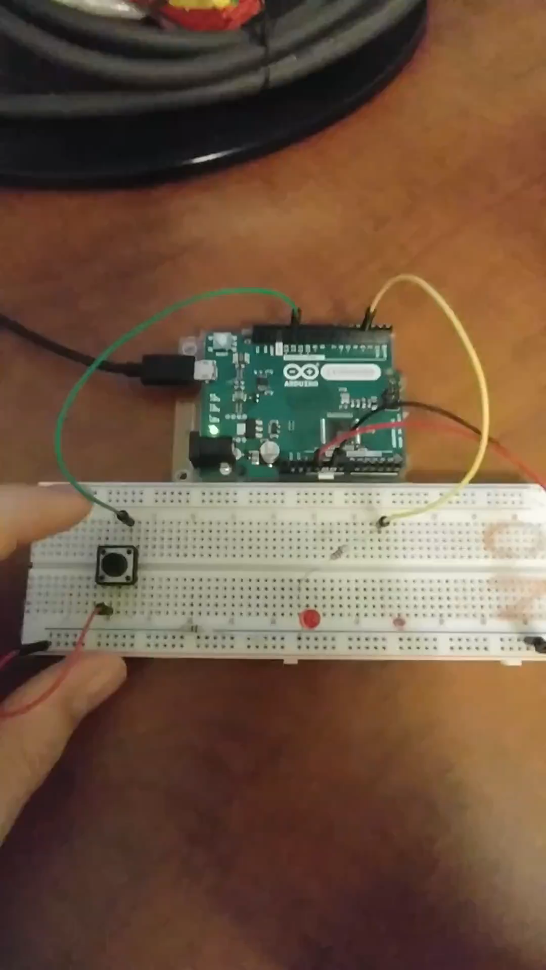

Button debouncing
Press once to turn it on, press again to turn it off:

Slide 4
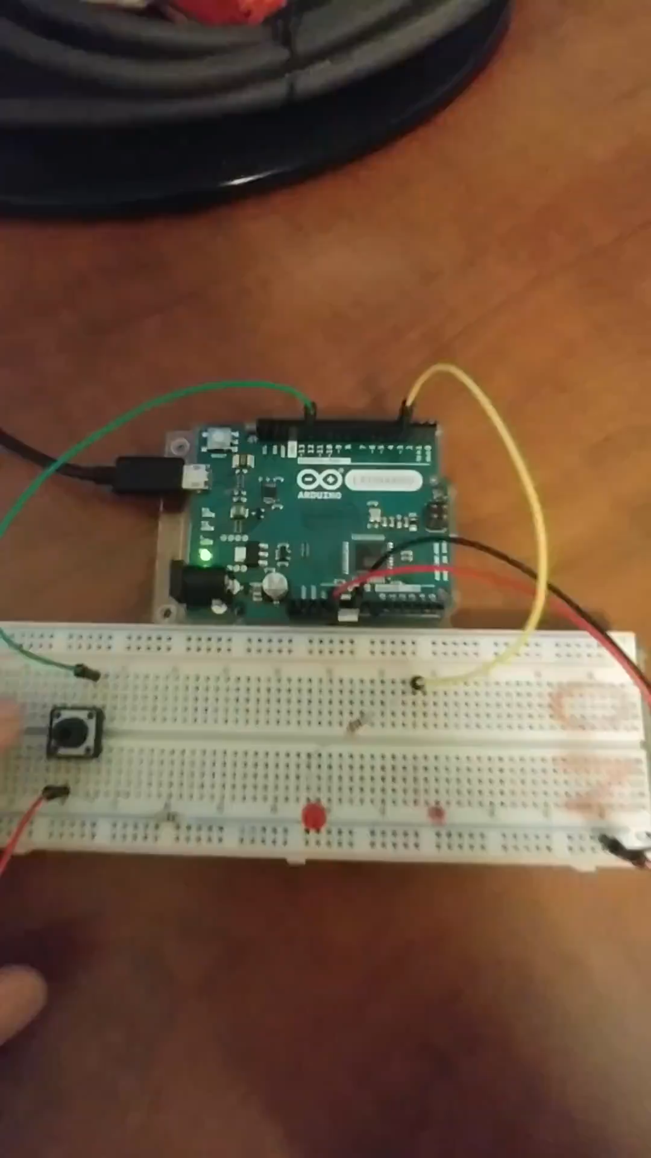

Button debouncing

Slide 5
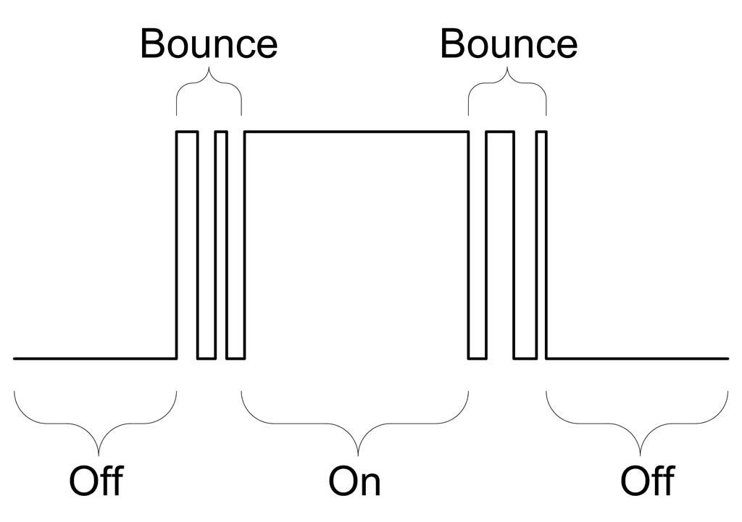
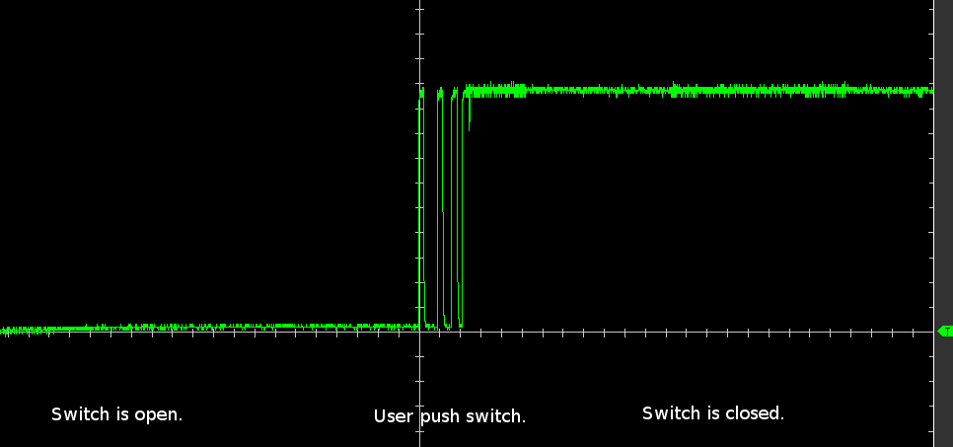
Button debouncing
Button signals are not perfect
Mechanical inefficiencies
Many fluctuations – noise
millis() returns an unsigned long
How many milliseconds have passed since the current program began executing (since last reset button)
Overflows after 50 days
Image: https://www.allaboutcircuits.com/uploads/articles/jc_osc_1a.png
Image: https://protostack.com.au/2010/03/debouncing-a-switch/

Slide 6
Button debouncing
digitalRead(BTN)
current reading
last steady state

Slide 7
Button debouncing
previous reading
current reading
last steady state

Slide 8
Button debouncing
previous reading
current reading
last steady state
previous change time
now
Time

Slide 9
Button debouncing
current reading
previous reading
last steady state
previous change time
now
Time

Slide 10
Button debouncing
previous reading
current reading
last steady state
previous change time
now
Time

Slide 11
Button debouncing
previous reading
current reading
last steady state
previous change time
now
Time
30 ms

Slide 12
Button debouncing
previous reading
current reading
last steady state
previous change time
now
Time
10 ms

Slide 13
Button debouncing
current reading
previous reading
last steady state
previous change time
now
Time
22 ms

Slide 14
Button debouncing
current reading
previous reading
last steady state
previous change time
now
Time
5 ms

Slide 15
Button debouncing
previous reading
current reading
last steady state
previous change time
Time
now
15 ms

Slide 16
Button debouncing
previous reading
current reading
last steady state
previous change time
Time
now
35 ms

Slide 17
Button debouncing
previous reading
current reading
last steady state
previous change time
Time
now
50 ms

Slide 18
Button debouncing
previous reading
current reading
last steady state
previous change time
now
Time
65 ms

Slide 19
Button debouncing
previous reading
current reading
last steady state
previous change time
now
Time
65 ms

Slide 20
Button debouncing
previous reading
last steady state
current reading
Time
previous change time
now
4 ms

Slide 21
Button debouncing
previous reading
current reading
last steady state
previous change time
now
Image: https://protostack.com.au/2010/03/debouncing-a-switch/
Time
50 ms

Slide 22
Example
https://github.com/GeoffSpielman/Hackathin_Examples or search GitHub for ‘Hackathin_Examples’
No circuit schematic this time – you got this

Slide 23
Example
currentReading
prevReading
prevSteadyState
prevChangeTime
millis()
Time
debounceTime

Slide 24
Example

